Slide 1
Roadside Futures
Report for the year 1 April 2023 – 31 March 2024

Slide 2
Moving for Change has continued to make good progress during a year in which the protracted cost-of-living crisis has significantly impacted Gypsy, Roma and Traveller communities and, consequently, seen a sector that is consistently under-resourced being stretched to its limits when responding to community needs.
Our partners have continued to deliver beyond expectations, and we thank them for their commitment to delivering to a cause common to us all. Along with ongoing projects, this year saw:
2 New Professional Mentorships
3 New Large-Scale Projects
8 Gypsy, Roma, Traveller History Month [GRTHM] Micro Projects
2 Test and Learn Digital Inclusion Projects
being commissioned as the MfC Network continued to grow.
The geographical reach of the programme was maintained with projects in Wales, Scotland and England and extended into Northern Ireland in the summer of 2023.
We also established a Crisis Grant Fund which distributed crisis funds to 366 individuals and families across the four jurisdictions during the year.

Slide 3
Commissions: £513, 493

Slide 4
Governance and Operations
Model and Structure
MfC operates as a Special Purpose Vehicle [SPV], the key elements of which are:
Network of Members
Impact Panel
Board of Directors
Core Spokes
(A Special Purpose Vehicle is a separate legal entity created to fulfil certain objectives. This entity generally has a predefined purpose and limited activity scope and is sometimes used as a short-term solution to a current or potential problem. )

Slide 5
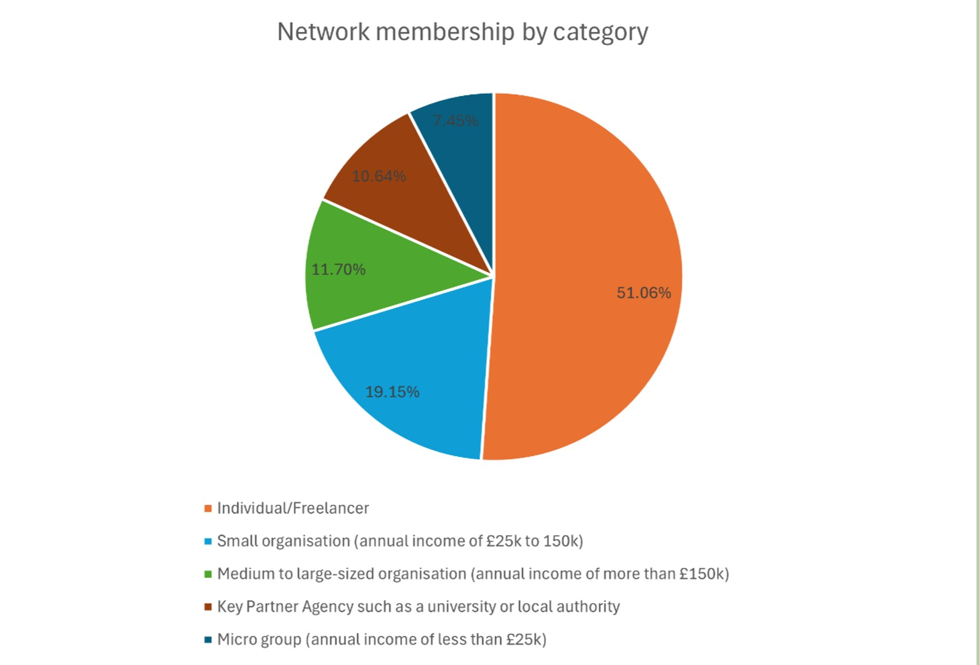
Network of Members
The Network continued to grow, with an increase of 20 members, bringing the total to 94.
Unfortunately, due to the Core Spokes’ roles and responsibilities experiencing significant change in this reporting period, our annual face-to-face Network Event had to be deferred until May 2024.

Slide 6
Impact Panel
Reflections on learning and the impact of the programme are built into our ongoing monitoring processes and the role of the Impact Panel.
Due to a change in Core Spokes roles and responsibilities and difficulties in aligning diaries, the panel held just the one meeting in 2023-24 at which they discussed three stories all of which focused on the work of the Core Spokes.
The stories were created and discussed using the Most Significant Change method. After the stories had been shared and discussed, the themes, ideas and suggestions were written up into reports which were then considered by the Board of Directors and Core Spokes.
(The Most Significant Change [MSC] technique is a participatory tool used for monitoring and evaluating projects and programmes. It involves collecting stories of significant change from those affected by the programmes, systematic participatory interpretation of these stories and discussing and selecting the most significant stories at various organizational levels thus it helps clarify values among stakeholders and provide evidence of impact.)

Slide 7
One of the key themes, during panel member discussions this year, was the vital importance of encouraging, nurturing and supporting younger members of the communities so that they could ‘carry the baton’ into the future. The Professional Mentorship Programme was valued for this reason, and the panel indicated that they would like to follow the progress of the programme as it developed.
In response to the panel’s points regarding the nurturing and support of young people to enable them to become activists of the future, MfC’s Commissioning Spoke developed a proposal for a UK wide ‘Young People as Human Rights Defenders’ project. This proposal was approved by the Board and went out to tender in February 2024. The project has now been commissioned and work will begin in May 2024.

Slide 8
Board of Directors
As we enter the penultimate year of funding from the National Lottery Community Fund, the Board, in collaboration with the Core Spokes and with input from Impact Panel members, partner organisations and individuals, has initiated an in-depth ‘look back’ and forward planning process. In terms of what and where to next, discussions to date have highlighted the following key points for consideration:
The community expect this movement to continue because there has been so much good work and support. If we do continue, what does that mean and look like?
It will certainly mean similar or more funding amounts and considering whether we remain a commissioning entity or in addition embrace a strategic convening role.
If there is a broadening of range and scope, we must know exactly what this will look like.

Slide 9
We should start these conversations with the NLCF [and other long-term funders] as soon as possible as further consultation with partners, community members takes time to ensure we are getting it right.
In addition, in relation to growth, we must ensure that robust qualitative and quantitative research vis-á-vis the current and emerging needs of the communities is undertaken to inform all future discussions and funding applications.
Our Core Spokes, partner organisations and commissioned projects will play a key role in collating existing views and opinions and promoting and supporting new research.

Slide 10
Core Spokes
The structure of the Core Spokes experienced significant change this year with both the Programme Management and Governance and Policy Spokes moving on from their roles. The MfC Board takes this opportunity to thank both LeedsGATE and Derbyshire Gypsy Liaison Group [DGLG] for their contributions to the success of our work over the past four years.
Programme Management was handed over to the Commissioning Spoke, and Governance [support to the Board] to York Travellers Trust [YTT]. Policy work will be commissioned on an as-and-when basis.
The remaining three Spokes continue to meet regularly to share information and updates and identify areas for joint working. The planning and delivery of events, proposals for future commissions and the support to and ongoing evaluation of the Professional Mentorship Programme are good examples of this joint work.
The next 11 slides highlight the wide-ranging work undertaken this year by the three remaining Core Spokes.

Slide 11
Communications Spoke
While there have been some knock-on effects from the change in structure, MfC’s Communications Spoke has continued to act as a two-way conduit for the Network and Board.
Social Media
Traditionally speaking, Facebook and Instagram have been seen as the most effective means of communicating with members of the Gypsy, Roma and Traveller communities in terms of social media. However, the year April 2023 to March 2024, has seen a more nuanced picture, particularly with regards to growth in terms of followers and levels of engagement.

Slide 12
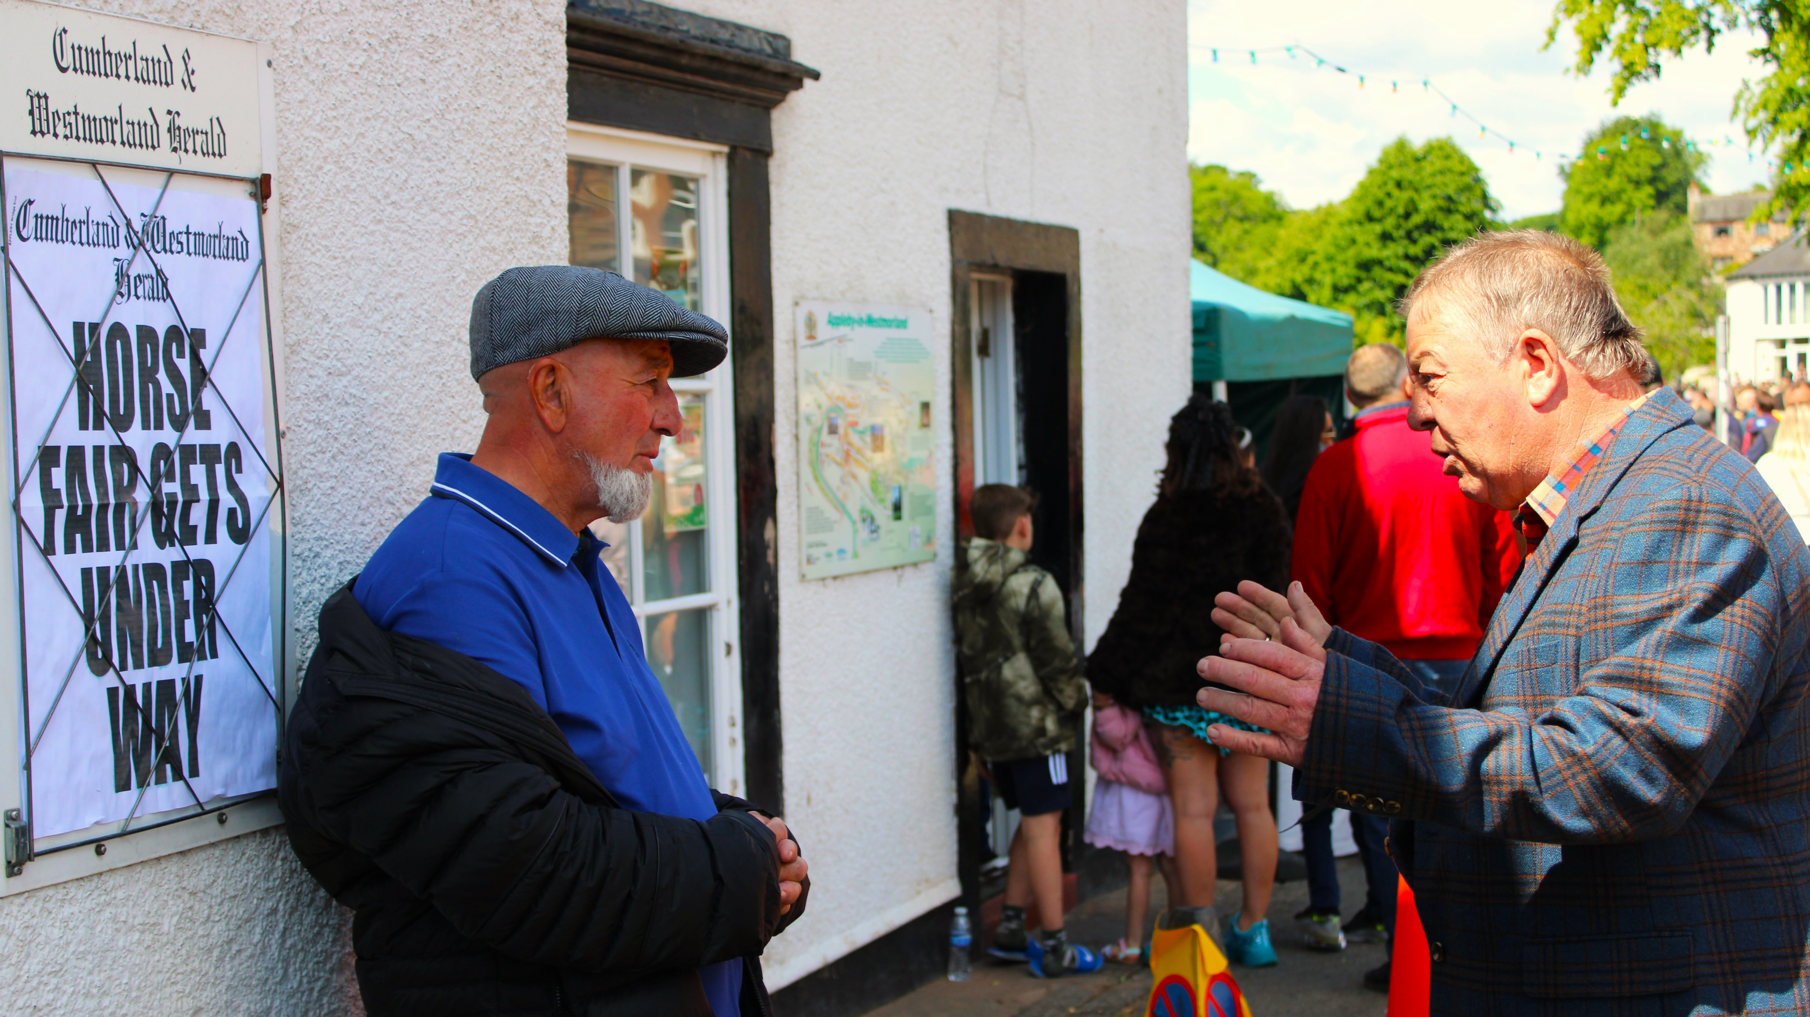
Facebook and Instagram
Overall analytics of this period show that MfC had an increase of 2% Facebook reach [13,275 individuals over eighty published posts]. Whilst the numbers of posts are reduced on last year, it seems a more targeted approach to both platforms has paid off, with an increase of 41.6% in content interaction and 112.2% in link clicks [834 and 261 respectively] whilst 31 Instagram posts reached 2,738 people or groups.
Demographically, the audiences for both platforms are equivalent in terms of female-male split [69.1% female and 30.9% male on Facebook; 67.5% female and 32.5% male on Instagram]. However, the median age range for Facebook and Instagram differ, with Facebook peaking in the 34 – 44-year-old groups, while approximately 30% of MfC’s Instagram engagement is with the 25 - 34-year-olds. This remains much the same as last year, although with a curious downturn in male engagement on Facebook matched by a similar percentile upturn on Instagram.

Slide 13
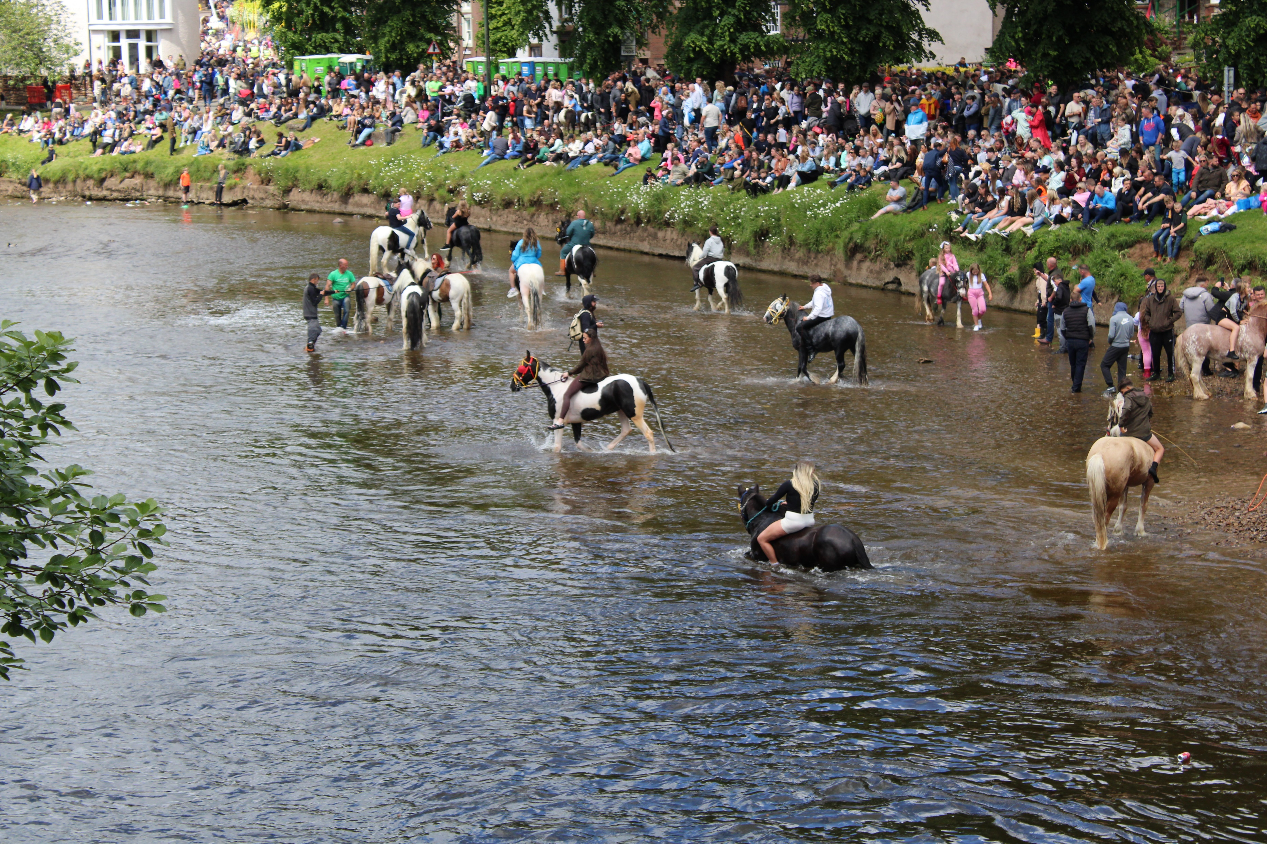
X
X [formerly Twitter] analytics don’t offer the same level of demographic breakdown as Facebook and Instagram but there has been an ongoing increase in engagement, achieving some 48,788 impressions. Given its nature as a debating platform, rather than simply a point of information, X clearly has a place in the world of MfC, particularly given the uncertainties still being created by the Police, Crime, Sentencing and Courts Act
The consistent rise in followers for MfC’s X account is a sign of current times and ought not be overlooked.
How we reach more men, of any age range, remains a challenge which may have to be resolved outside of social media posts and more in terms of video and audio content.

Slide 14
Newsletter and Website
The newsletter has remained consistent with its number of recipients rising from 91 to 106 over this period and clicks to open ranging from 37.9% to 52.4%. Having established the newsletter as a regular feature of MfC’s life, the last year has seen a new methodology in garnering stories – directly approaching Network Members rather than simply following the social media posts of affiliated groups and individuals. This allows the e-mails requesting information and contributions to be part of the conversation.
Photographic and video content is now playing a more significant part in the newsletter’s content while there are now plans to have the newsletter’s text available via a spoken word to broaden its reach. Whether this is done via human voiceover or AI has yet to be decided.
Like the Newsletter, the website has sustained itself at a consistent level with an average of 241 users per month and page views ranging between 493 and 760. Inevitably, these figures have been dependent on the news of new commission opportunities. The development of new forms of network engagement – video interviews, podcasts and so on – offer an opportunity to have the website better reflect the community that MfC has become.

Slide 15
Learning and Development Spoke
The Learning and Development Spoke has continued to offer much needed advice and support to both network members and community members from outside the Network.
This support has been crucial during the cost-of-living crisis and to those with grave concerns regarding being at best moved on and a worst having their trailers taken from them under the auspices of the PCSC.
In response to the outcomes of consultations with community members, the Learning and Development Spoke has facilitated or delivered a number of workshops and events. Fundraising 101 was just one example…

Slide 16
Fundraising 101
38 network members - 25 women and 13 men – attended these 4 highly interactive workshops, designed to help to develop participants’ knowledge and practical understanding of all forms of fundraising.
Introduction To Fundraising
Measuring Your Impact
Prospecting And Research
Writing For Impact
- I really enjoyed the fundraising workshops they will help me to develop a practical fundraising action plan for my organisation. I feel more confident now in fundraising [Romany Gypsy].
- This was a really valuable workshop it will help me to develop a strong foundational understanding of different types of fundraising and how to explore what options are available and what will work best for our organisation [Traveller Woman].

Slide 17
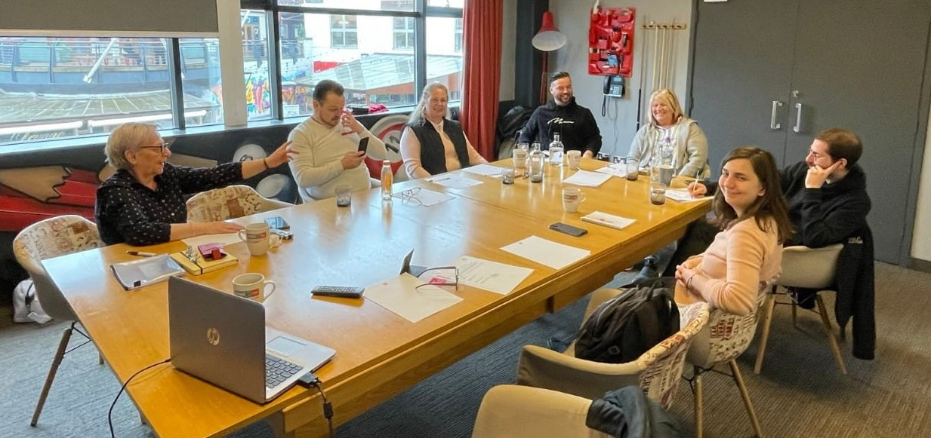
Professional Mentorship Programme Support
In addition to learning and development events, the Spoke has provided in-depth and ongoing support to participants of our Professional Mentorship Programme including the design and delivery of the first in-person group meeting of participants. This event brought together mentors and mentees engaged in the Programme and provided them with the opportunity to share experiences, raise achievements and challenges and inform MfC on how the Programme could be improved…

Slide 18
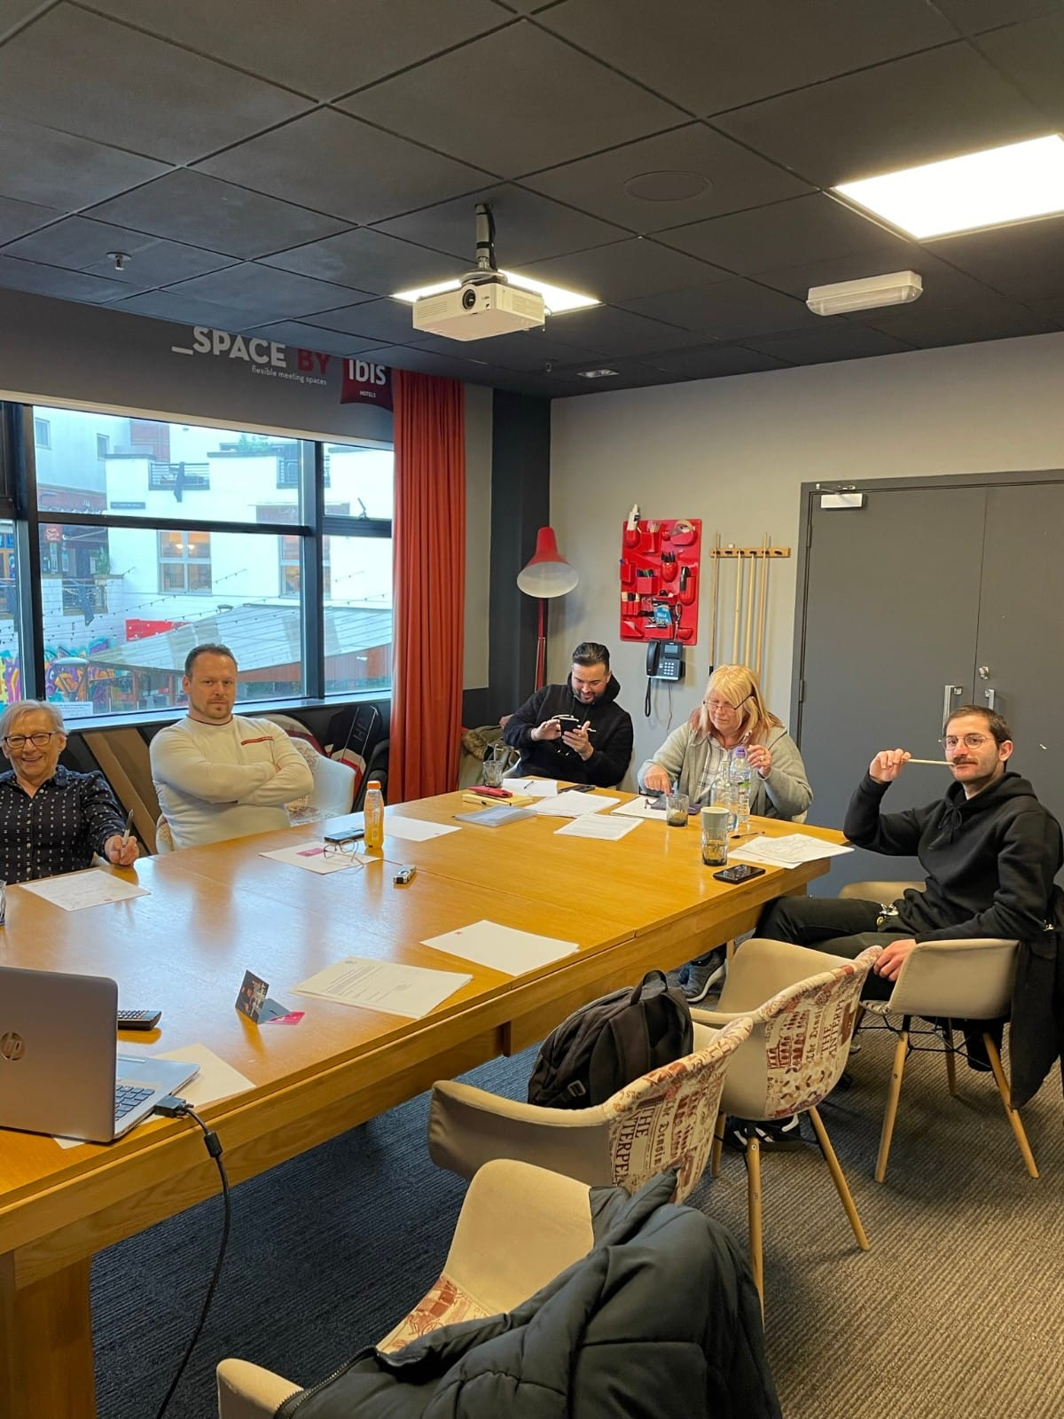
All mentees saw the Programme not just as an opportunity to gain more skills, but also as a chance to act as mentors for future applicants, and to help increase Gypsy, Roma and Traveller representation and participation within their own areas.
Through having an official position, all mentees felt empowered to make their voice heard and to state their cases in places or institutions where it may not have previously been possible.
The mentees took pride in the flexibility of the programme and about their close working relationships with their mentors and their professional environments.
Learning and development over the last year has taken on many forms, from Emergency Aid to Excel to the Open University.
The marriage of minds between mentor and mentee was crucial to the Programme’s success or failure.
Whether a new Professional Mentorship Programme can be rolled out by MfC after this will depend on many factors. But MfC seems to have developed a fresh model of training, with possibly wider-than-our-sector applications.
In ten years’ time, we’re expecting future mentees to be running things, and we’re not alone in that.
- Who better to help our people than us ourselves? [MfC Mentee].

Slide 19
Commissioning and Contract Management Spoke
A key focus of this reporting period was how MfC could best meet the needs of families and individuals experiencing financial hardship due to the ongoing cost-of-living crisis.
Following discussions with community members and partner organisations it was agreed that a ‘crisis fund’ would be established which organisations could access onward distribution at grass roots level.
As anticipated, the funds were accessed and distributed within days of the commissioning call. The fund gave much needed support to 366 families [including 572 children under the age of 16] and individuals from across the four jurisdictions, with use including the purchase of food, fuel and school clothing.

Slide 20
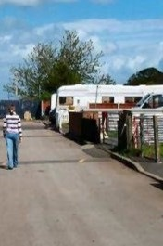
Breakdown of grants by jurisdiction:
England: 235 individuals/families, 328 children;
Scotland: 6 individuals/families, 20 children;
Wales: 22 individuals/families, 44 children;
Northern Ireland: 73 individuals/families, 180 children
[note these high numbers are due to small value Lidl vouchers being issued].
To enable partner organisation to meet existing and begin to address emerging need, we extended currently-commissioned projects by one year. In addition, 3 new projects focusing on local and national planning policy and processes and site provision, 2 new Professional Mentorship placements and 8 GRTHM micro projects were commissioned during this reporting period.

Slide 21
Contract Management
The major challenge for the Commissioning Spoke Lead this reporting process was the merging of Commissioning and Contracts Management due to the organisation responsible for Programme/Contracts Management moving on in December 2023.
Whilst this challenge presented the Commissioning Spoke Lead with a need to ‘hit the ground running’ to ensure continuity of support to commissioned projects and the Board, it also presented an opportunity to streamline roles and responsibilities, assess and reset/rewrite reporting processes and forms and achieve a reduction in administration costs.
Four months on, the Commissioning Lead has settled into her new role and feedback from commissioned projects vis a vis the new reporting and support processes has been positive.

Slide 22
Spotlight On Projects
This year has seen our geographical reach extend to Northern Ireland – meaning that we are now Moving for Change in all four jurisdictions of the UK. This is a major achievement and one we are proud of.
The diversity of commissioned projects is also to be celebrated, from Education at the Roadside with Gypsy Travellers in the Scottish Highlands, to Professional Mentorships and digital inclusion work with young Roma in Armagh, to the Churches Network Sanctuary Stopping Project in England, to research projects in Wales and many more in between, we are supporting individuals and organisations to improve the quality of life for Gypsies, Roma and Travellers living roadside or in insecure accommodation and the communities in which they live across the UK.
The following is a snapshot of the diversity and geographical range of our ongoing and newly commissioned projects.

Slide 23
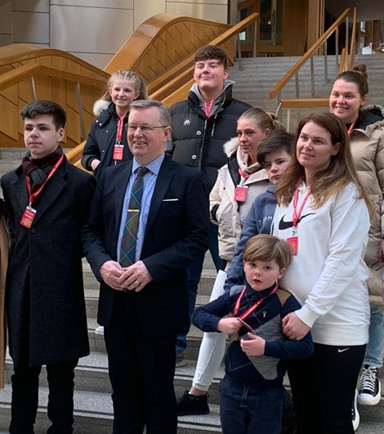
Scotland
Article 12 in Scotland: Education at the Roadside
Agreed Outcomes
1) Improved educational and employment/self-employment opportunities for young Gypsy/Travellers who are shifting or living roadside in North-East Scotland and the Scottish Highlands while building a bespoke support system that ensures continued support while families shift.
2) Increased knowledge and participation for young Gypsy/Travellers who are shifting or living roadside in North-East Scotland and the Scottish Highlands regarding their rights [particularly, but not exclusively, education and participation rights] as individuals and as a community. Increased engagement by young Gypsy/Travellers in the UNCRC Reporting Process and other advocacy opportunities.
3) Increased knowledge and sharing of successes and lessons learned from developing a scalable model of supporting young people whose families are roadside.
Young Scottish Gypsy Travellers at the Scottish Parliament with Alexander Stewart, MSP.

Slide 24
Progress This Year
12 young Gypsy/Travellers [11f/1m] are currently engaged with the programme and 6 Gypsy/Traveller adults have been supported through our work with their children and young people.
8 young people have now learned about their rights through a workshop with the Article 12 in Scotland worker. There are no major barriers when delivering these workshops, but the variety of ages of the young people requires the worker to modify the material to keep them engaged at an appropriate learning level.
3) The worker has been very successful at building partnerships to increase positive support to families living roadside. Highland Council and Moray Council have been the most responsive and she has liaised with a variety of roles, such as the housing department, site managers, and public health workers.
She also has an ongoing partnership with the NHS to improve health outcomes in the Gypsy/Traveller community and with the Highland Council Gypsy/Traveller Improving Lives Delivery Group.
In these multiple partnerships she has been able to teach others about how to reach roadside families with needed information/support, and has been able to advocate for the needs of roadside families.

Slide 25
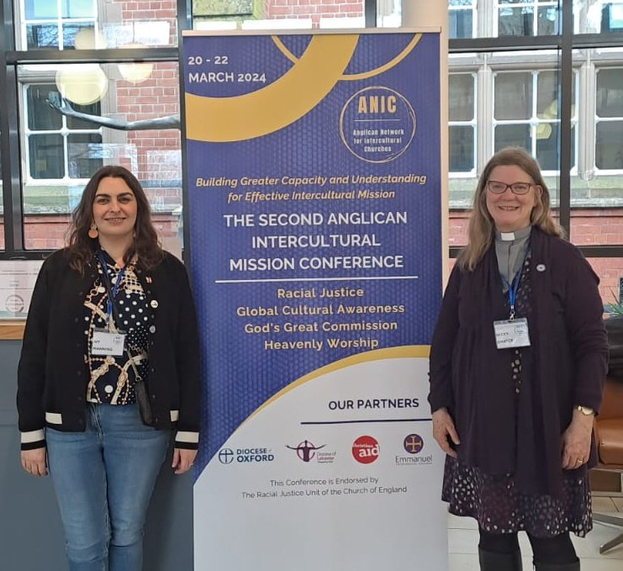
England
Churches Network: Sanctuary Stopping [CNSS]
Agreed Outcomes:
1) To increase awareness of Traveller Friendly Churches amongst existing members of the Churches Network and cross-agency partners.
2) To increase the number of existing Churches Network members and cross-agency partners adopting the Traveller Friendly Churches concept.
3) Increased promotion and awareness raising, online and at events.
Members of CNSS at the Anglican Intercultural Mission Conference.

Slide 26
Progress This Year
1) CNSS has raised awareness via webinars, newsletters, prayer meetings, in-person conferences, and taking part in workshops and plenaries working at a national and international level. They have met with local clergy and church leaders and members to break down barriers and challenge fears and negative stereotypes and have kept dialogue going with the communities and their networks and organisations on issues and their needs and wants.
2) CNSS subscriber numbers have increased by 36% in the last year. They now have five religious spaces displaying the Gypsy, Roma, Traveller Friendly Church [GRTFC] logo. Six dioceses have shown an interest in the concept of sanctuary stopping and have invited CNSSS to conversations that have involved the discussion of land use. Connected to these discussions is an interest from the relevant Local Authorities in showing support for the use of church land for sanctuary stopping in their areas.
3) The CNSS website is regularly updated and revised along with their social media. They are in dialogue with a number of community members vis a vis what sanctuary stopping should look like and where it would be best situated to meet their nomadic needs. They will be continuing these community conversations in the spring and summer of 2024 at events such as Appleby Fair, Roma festivals and GRTHM events.

Slide 27
Northern Ireland
Armagh Roma and Traveller Support [ARTS]:
Professional Mentorship Programme
Agreed Outcome:
Improved and increased opportunities for Gypsies, Roma and Travellers to engage in high quality work-based learning and development which will equip them with the skills and knowledge necessary to gain employment or engage in further formal learning and training.
Progress This Year
ARTS engaged three young Roma females in the Professional Mentorship Programme this year. One returned to Bulgaria for marriage, but we are confident that she will return later in the year to complete her course and gain her qualifications.
Regarding the other females, M is progressing well at college with good reports from her teachers in the business studies course. She works one day a week with us on her day off from the college, sometimes two. She undertakes a range of tasks which includes creating flyers for projects and completion of risk assessments strategic planning and funding applications and events planning. This blends in well with her college work.

Slide 28
N is working well in the beauty course achieving good results in all her assignments and exams. She undertakes days where she must deliver what she has learnt to clients in the form of treatments. She attends with us once a week and sometimes twice or more depending on her timetable at college. She also works with the after-school club on a Friday evening and projects on Saturdays.
She is also going to be involved with our up-and-coming Prince’s Trust Beauty Course in the New Year.
Like M, N uses our offices to study and complete course work on the computer and to print off and complete her assignments.
Both girls are also studying for their theory driving test with us and helping others who don’t speak the language to do theirs.

Slide 29
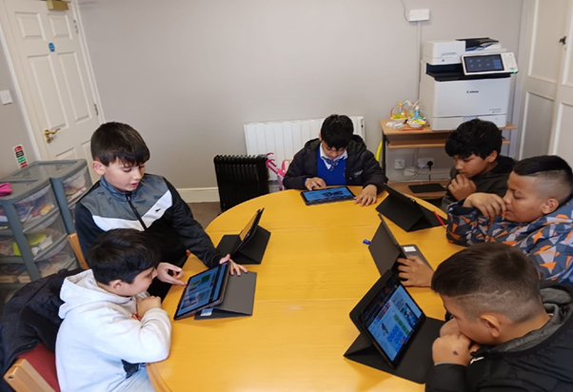
Digital Inclusion project
Agreed Outcome:
A ‘Test and Learn’ project to give MfC a clearer understanding of the needs and benefits of digital inclusion projects - particularly how equitable access impacts on young Gypsy, Roma, Travellers’ ability to engage in further education and vocational training.
Progress This Year
MfC funding enabled ARTS to purchase 3 laptops, 9 tablets, a printer and assign 150 hrs of worker time to engage young people in the project.
One young boy, aged 10, moving from primary to secondary school, was to be held back a year as he was not progressing at an appropriate level, according to the school. He has attended regularly, even volunteering to stay behind after the others have gone for extra learning. He is now completing his homework and classwork on time and looks set to move on this year.
A young girl was told by the school that she was not capable of progressing to the next level without private tutoring. The family didn’t have the means to do this. She too has attended regularly and is progressing well, again hopefully to the next school level.
Young Roma attending the homework project.

Slide 30
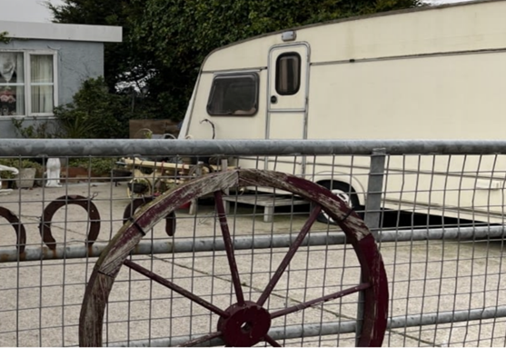
Wales
Gypsies and Travellers Wales: Rover Way [site] – Researching The Future
Agreed Outcomes:
1) Improved accommodation provision.
2) Improved access to health services.
3) Improved access to learning, training and work opportunities.
Progress This Year
1) Over this reporting period the worker focused on research and documentation regarding the current situation and the future accommodation needs of community members. The next stage of research will involve time spent on Rover Way and Shirenewton [local council sites] both researching in person with communities and auditing the needs of the sites.
Pitch on Gypsy Traveller site, Wales.

Slide 31
2) The worker was also commissioned to undertake research work for Public Health Wales, looking specifically at ‘Service Mapping for Communicable Disease Inclusion Health Programme: Gypsy and Traveller Communities in Wales’.
This crossed over with mapping general health services in Cardiff specifically and Wales more generally. The worker is now considering how best to improve engagement with health services and has recommendations to make to health services and larger authorities, such as Local Authorities and the Welsh Government.
3) Gypsies and Travellers Wales have undertaken a broad programme of training opportunities for Gypsies and Travellers, including one person being trained and funded by Prince’s Trust and several people benefitting from Driving Theory Test Training.

Slide 32
Concluding Observations
Despite the challenges of significant change to the structure, roles and responsibilities of the Core Spokes and against a backdrop of an unprecedented cost-of-living crisis which has had a profound impact on the Gypsy, Roma and Traveller communities of the UK, MfC is proud to have been in a position to provide respite and peace of mind to 366 individuals and families [with 572 children between them] via our crisis grants project.
This, alongside our current and new projects, has enabled us to maintain and indeed enhance our position as an entity that can, and will, respond to immediate need and, as importantly, be trusted by communities and organisations and agencies alike to assist them in delivering real and sustainable change for Gypsy, Roma, and Travellers across the UK.
As with previous years, we are proud of the way we have developed over this reporting period and move into 2024-25 with great optimism.

