Slide 1

Roadside Futures
Report for the year 1 April 2024 – 31 March 2025

Slide 2
Moving for Change has once again made good progress against the continued background of a cost-of-living crisis and its significant impact on the Gypsy, Roma and Traveller communities.
The introduction of a new government has seen MfC partners engaged in consultations at the heart of policy, in reviews of the National Planning Policy Framework and the National Curriculum.
Likewise, the prominence of MfC partners in the response to the Greater Manchester Police’s treatment of Romany Gypsy and Irish Traveller children in December 2024 is an indication of not only the unity within our network but also their tenacity in ensuring the injustices faced by the communities remain in the public eye.
The publication of The Modern Nomad vision document has provided a concrete example of the potential for network collaboration to create a truly groundbreaking resource for all.
Despite this being the last year of the current funding programme the last twelve months have seen:
1 new large-scale project
7 mentorships across four organisations
11 GRTHM micro-projects
130 individuals and families benefitting from the crisis grant fund

Slide 3
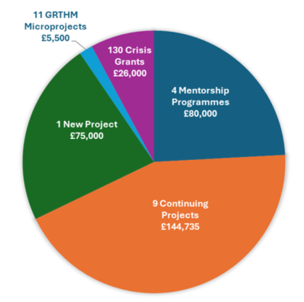
Commissions: £299, 735

Slide 4
Governance and Operations
Model and Structure
MfC operates as a Special Purpose Vehicle [SPV], the key elements of which are:
Network of Members
Impact Panel
Board of Directors
Core Spokes
(A Special Purpose Vehicle is a separate legal entity created to fulfil certain objectives. This entity generally has a predefined purpose and limited activity scope and is sometimes used as a short-term solution to a current or potential problem. )

Slide 5
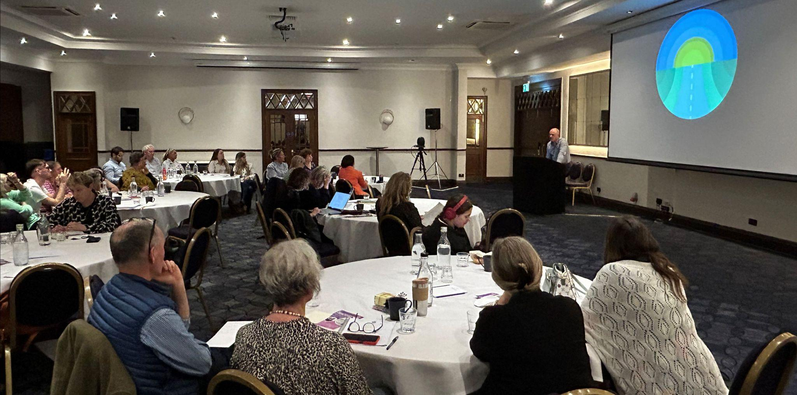
Network of Members
The Network continued to grow, with an increase of four members, bringing the total to 98.
The annual face-to-face Network Event took place in May in York with contributions from representatives of YTT, DGLG, the Churches Network, Armagh Roma and Traveller Support (ARTS), The Modern Nomad project, Kushti Bok and FFT (launching the Transit Site project).

Slide 6
The collegiate nature of this event - emphasising conversation over Cluster Group workshops - meant that more direct feedback regarding MfC’s impact was available, with the sharing of personal stories and perspectives being a particular facet - reflecting the recommendations of the Impact Panel (below).
Three of the key takeaways were:
The improved intercommunication between individuals and organisations
The fully national scope of MfC’s reach (with the presence of ARTS bringing Northern Ireland properly into the fold for the first time)
The growing demand for both regional gatherings and continued peer exchange.

Slide 7
Impact Panel
Reflections on learning and the impact of the programme are built into our ongoing monitoring processes and the role of the Impact Panel.
.
Network stories were discussed using the Most Significant Change method. After the stories had been shared and discussed, the themes, ideas and suggestions were written up into reports which were then considered by the Board of Directors and Core Spokes.
(The Most Significant Change [MSC] technique is a participatory tool used for monitoring and evaluating projects and programmes. It involves collecting stories of significant change from those affected by the programmes, systematic participatory interpretation of these stories and discussing and selecting the most significant stories at various organizational levels thus it helps clarify values among stakeholders and provide evidence of impact.)

Slide 8

Collaborating with the Impact Panel helped bring more depth to our evaluation processes. Two particular conclusions have helped shape the developing nature of MfC.
Their emphasis on measuring lived experience, not just numbers, aligning as it does with the Learning & Development approach.
Impact should be understood through stories, relationships, and trust, not just stats and KPIs.

Slide 9

Board of Directors
The board continued to meet regularly during the year to steer the direction of the work, it priorities and delivery.
As we enter the final year of funding from the National Lottery Community Fund, the board has continued to both ‘look back’ and plan future processes. In terms of what and where to next, discussions have highlighted the following key points for consideration:
Given that MfC is reaching the end of its current funding cycle, what does continuation mean and look like?
Does MfC need to consider a strategic convening role or simply act as a commissioner of projects? Or are there different, more inclusive ways of working with the network in the creation and allocation of new projects?

Slide 10


The next year will see MfC’s current tranche of commissioned projects coming to an end and permit the Board, the Core Spokes and partner organisations to take a fully-informed overview of where MfC has made an impact and what areas can be improved upon.
Clearly, whatever future form and role the organisation takes will be dependent on the views and aspirations of members of the communities it serves and the rest of 2025 will see greater strategic consultation at a variety of levels.

Slide 11
Core Spokes
The structure of the Core Spokes experienced significant change this year with the decision of the Commissioning Spoke to move on from her role. This role - essentially overseeing and supporting the completion of already-commissioned projects - is now being undertaken by the Comms Spoke.
The MfC Board takes this opportunity to thank Dr Lynne Tammi for her massive contribution - both as an individual and as a colleague - to the success of our work over the past five years. Her energy and advocacy have been central to the evolution of MfC as an entity and will be missed.
The remaining Spokes continue to meet regularly to share information and updates and identify areas for joint working. The planning and delivery of events and the support to and ongoing evaluation of the Professional Mentorship Programme are good examples of this joint work.

Slide 12
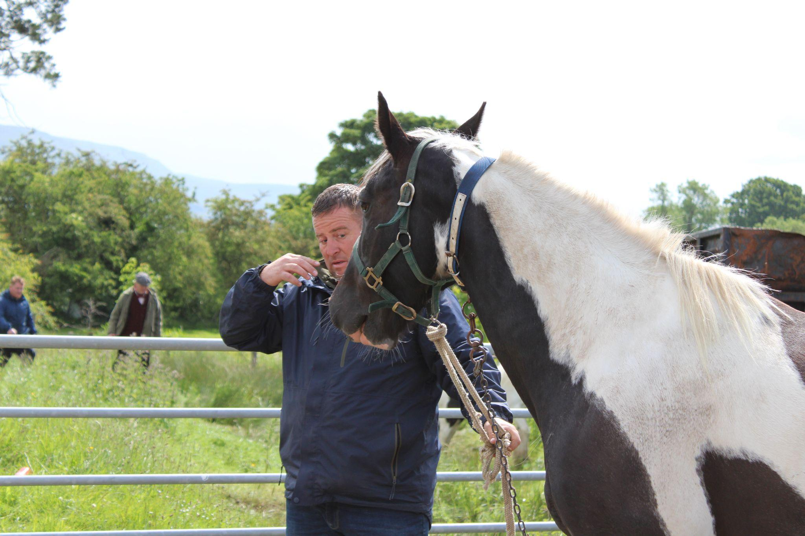
Communications Spoke
The year in communications has been one of flux, partly as a result of developments within the world of social media, partly as a result of political changes within the wider world. While this is to be expected with any organisation over a dual election year (UK and US), there were also unique challenges within MfC that required attention and alleviation.
While the Newsletter has essentially remained unchanged with an average of 47.6% opens and 12.9% clicks, X engagement has fallen, but Facebook (and by extension Instagram) engagement have risen by a significant amount.

Slide 13
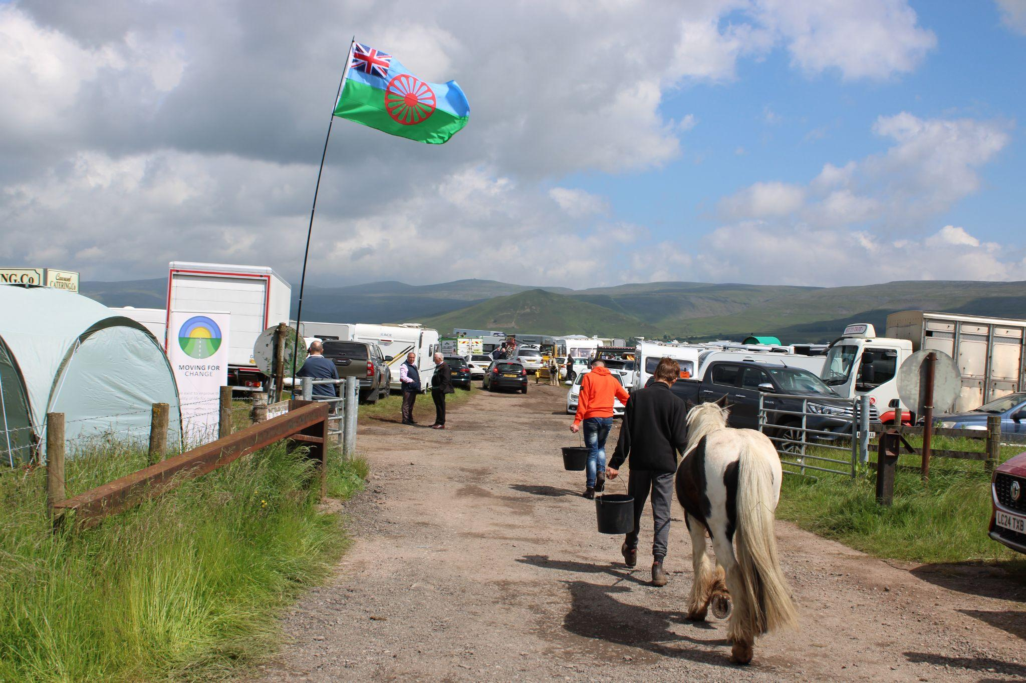
Facebook and Instagram
Facebook engagement in this last year has risen by 71% (22, 760 views) with an increase of followers to 403 (a rise of 26.5%).
Curiously, the biggest regional city engaging with MfC’s Facebook is Belfast.
While the demographics of MfC’s Facebook audience remain consistent with previous years, it seems clear that it is now the single most significant platform that MfC reaches, as opposed to alternatives such as Bluesky and Threads.

Slide 14
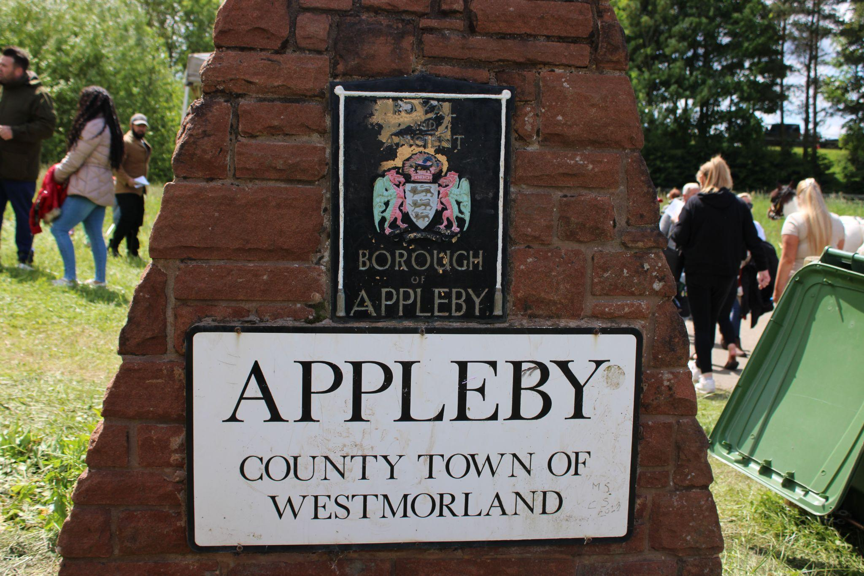
Youtube and X
YouTube also proved to be an increasingly effective and popular means of disseminating information, with rising numbers of network organisations creating their own videos and one of our own interviews (at Appleby Horse Fair) receiving more than 1,000 views in a week.
Meanwhile, although it’s difficult to quantify due to X having placed its figures behind a firewall, the drop in engagement is clear from the relatively low numbers of response to items posted on X and the similarly diminished levels of feed from organisations relevant or related to MfC.
Put simply, the changes to X both organisationally and within its demographic have massively reduced its effectiveness – and, indeed, suitability – as a platform for MfC.

Slide 15
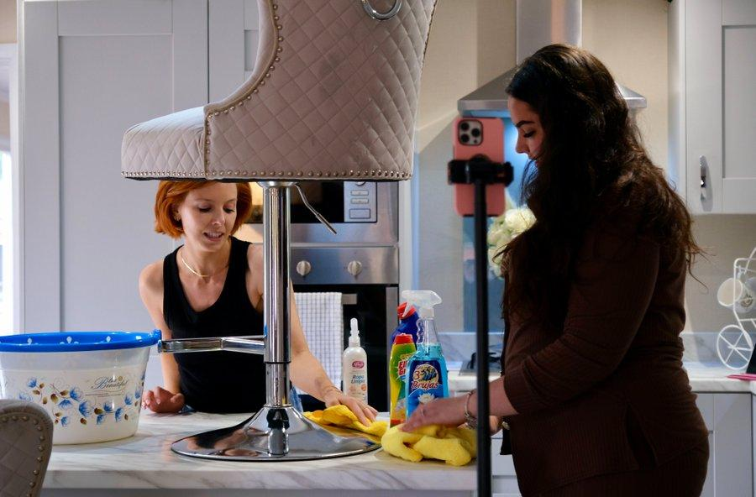
MfC was the subject of a series of negative comments, predominantly on Facebook, regarding its effectiveness and suitability as an organisation representing Gypsy and Traveller interests.
While it is not the place of this report to speculate as to the reasons behind these comments, it was clear that there were perception issues where the organisation was concerned. Rather than directly challenge the criticisms, it was felt the wisest policy was to emphasise the positive achievements of MfC over the years with a series of posts.
While these were apparently effective in the short term - coming at much the same time as the BBC3 Stacey Dooley documentary with our Chair Violet Cannon credited as consultant - it was a lesson to us all of the importance both of perception and transparency in our communications in future.
Photo © BBC

Slide 16

Learning and Development Spoke
This year has been one of deep listening, active engagement, and committed co-creation.
it has been a privilege to witness powerful stories, grassroots innovation, and an evolving understanding of what sustainable, inclusive support for roadside Gypsy and Traveller families truly looks like.

Slide 17

.
• Knowledge Sharing: We saw increasing collaboration across partners, with a clear move toward peer-led learning, whether through storytelling sessions or informal reflective spaces.
• Training Needs: A key learning was the variation in capacity and confidence among groups engaging with Roadside Futures. Some excelled in advocacy, while others needed tailored training on digital inclusion, trauma-informed work, or service navigation.
• Trust as a Foundation: Learning can't be imposed—it must be invited. This year reminded us that trust-building is the learning strategy, especially with groups that have been historically marginalised.

Slide 18
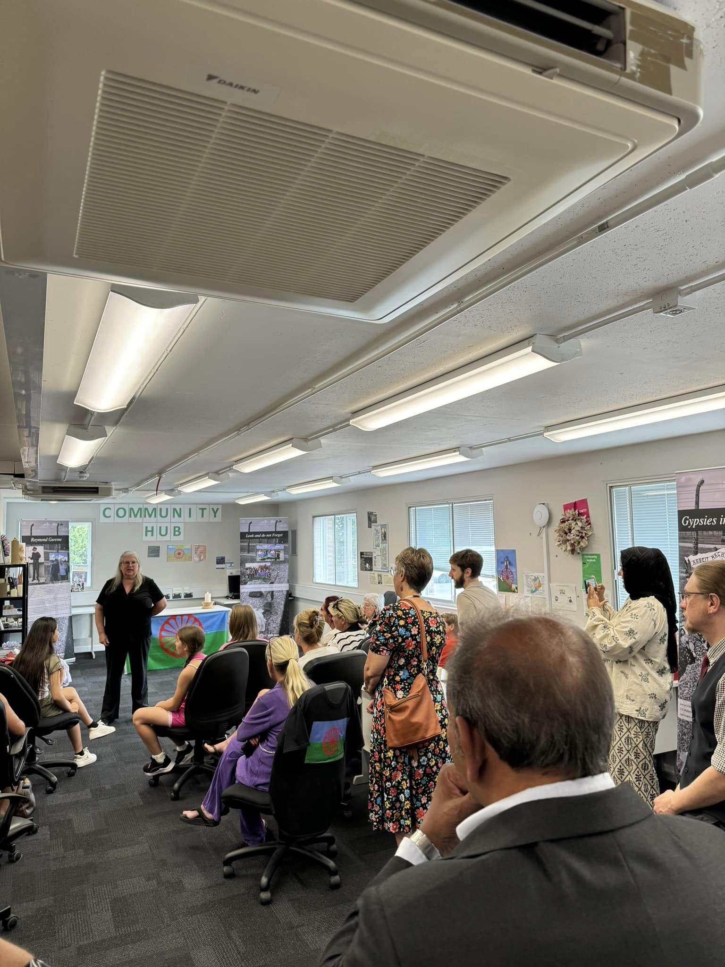
Community-led resources have been piloted and developed to reflect real experiences and avoid institutional jargon. Workshops facilitated with support workers and site residents were grounded in lived experience and aimed at shifting attitudes, not just increasing knowledge.
We also trialled reflective practice circles, providing practitioners with space to process challenges and successes in supporting roadside families.
As we move forward, the heart of our work remains clear: learning is not just about systems—it's about people, power, and possibility. Roadside Futures isn’t just a project. It’s a reimagining of how the GRT community can be heard, seen, and supported.

Slide 19
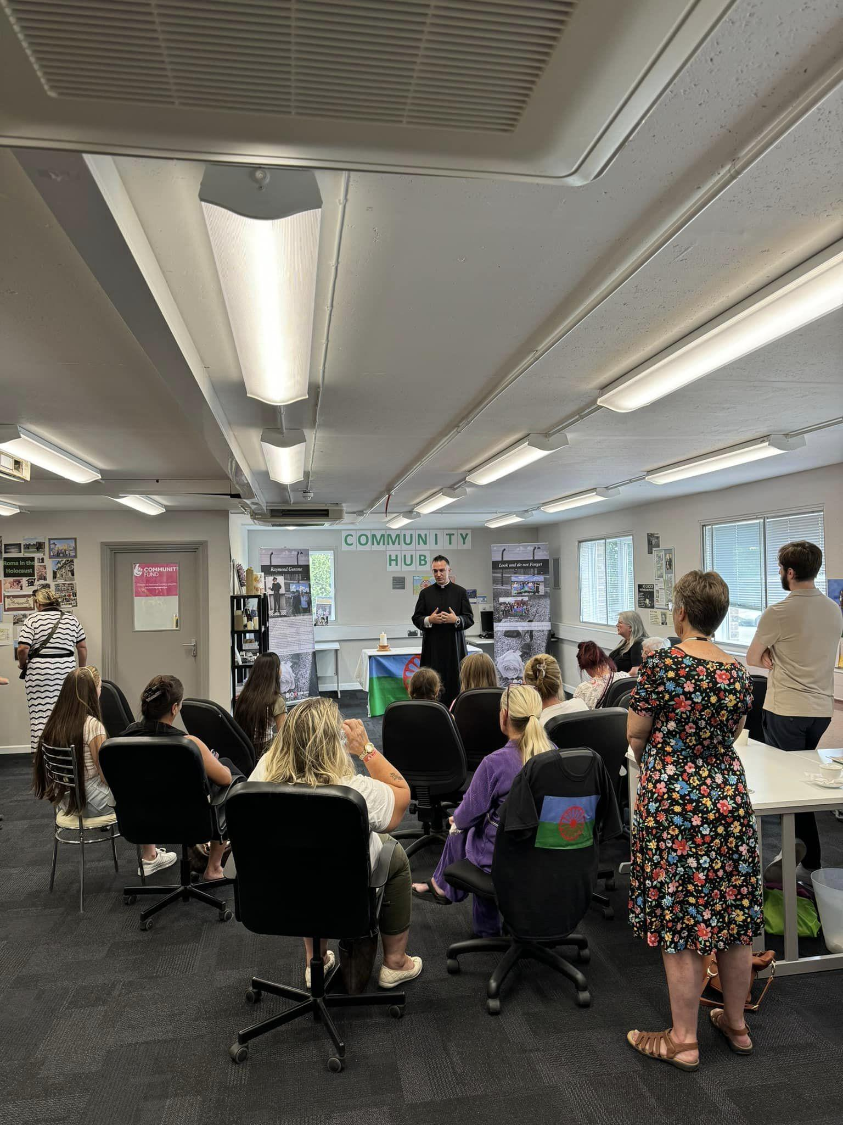
What’s Working
• Pathways for Progression: Supporting Traveller advocates in becoming trainers and facilitators themselves means leadership is emerging from lived experience.
• Listening Spaces: Creating space to hear what isn't being said in formal feedback - fears, family pressures, unmet needs - has been vital.
• Flexible Delivery: Offering learning in formats that respect people’s time, literacy levels, and mobility (e.g., WhatsApp videos, podcasts, mobile sessions) made a real difference.
Challenges and Reflections
• Institutional Resistance: Some agencies remain slow to shift. We learned the value of reframing language to open doors.
• Burnout in Community Organisers: We observed signs of strain among those doing frontline work with little support. Embedding wellbeing in our learning model will be essential next year.
• Capturing Impact: It remains a challenge to document how learning shifts practice. We’re exploring more creative and culturally rooted forms of evaluation (e.g., story circles, digital scrapbooks).

Slide 20
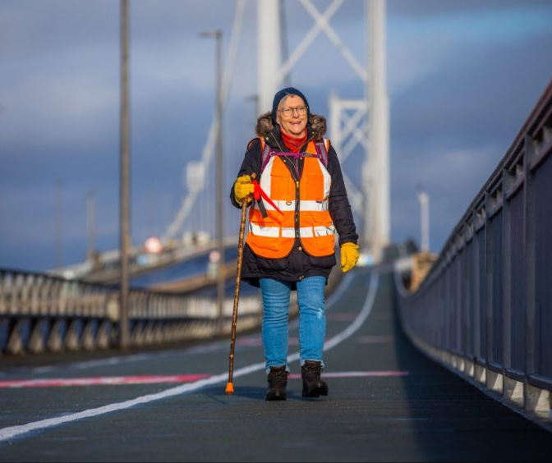
Commissioning and Contract Management Spoke
As mentioned above, the role of Commissioning and Contracts Management was passed on to the Communications Spoke in January 2025. The handover between spokes was a straightforward one, with the new reporting and support processes - along with the generous guidance of the outgoing Commissioning Spoke - overcoming any significant hurdles.
The next year is expected to be one of simple “guiding in” of remaining commissions and the Communications Spoke foresees few problems ensuring a “safe landing” for all concerned.
Still, we’re going to miss you Lynne.

Slide 21
Following last year’s extensive uptake of grants from MfC’s crisis fund to meet the needs of families and individuals experiencing financial hardship due to the ongoing cost-of-living crisis, the decision was made to extend the scheme into this year. As a result, a fund of £26,000 was divided between 130 families and individuals from across the four jurisdictions, with use including the purchase of food, fuel and school clothing.
In addition to the currently commissioned projects having been extended into this year, a new project focussing on the provision of transit sites, two new Mentorship placements (in Armagh) and eleven GRTHM micro projects were commissioned during this reporting period.

Slide 22
Spotlight On Regional Projects
Scotland
Article 12 in Scotland: Education at the Roadside
Agreed Outcome 1: Improved educational and employment/self-employment opportunities for young Gypsy/Travellers shifting or living roadside in North-East Scotland and the Scottish Highlands while building a bespoke support system that ensures continued support while families shift.
14 young Gypsy/Travellers (13f/1m) are currently engaged with the programme and 8 Gypsy/Traveller adults have been supported through our work with their children.
Article 12 in Scotland’s Children Services worker Eilidh Mcleod’s work to engage with young people and their families has included visiting multiple encampments throughout the region to introduce herself, help with signposting to/liaising with services, and offering educational support for age appropriate families.

Slide 23
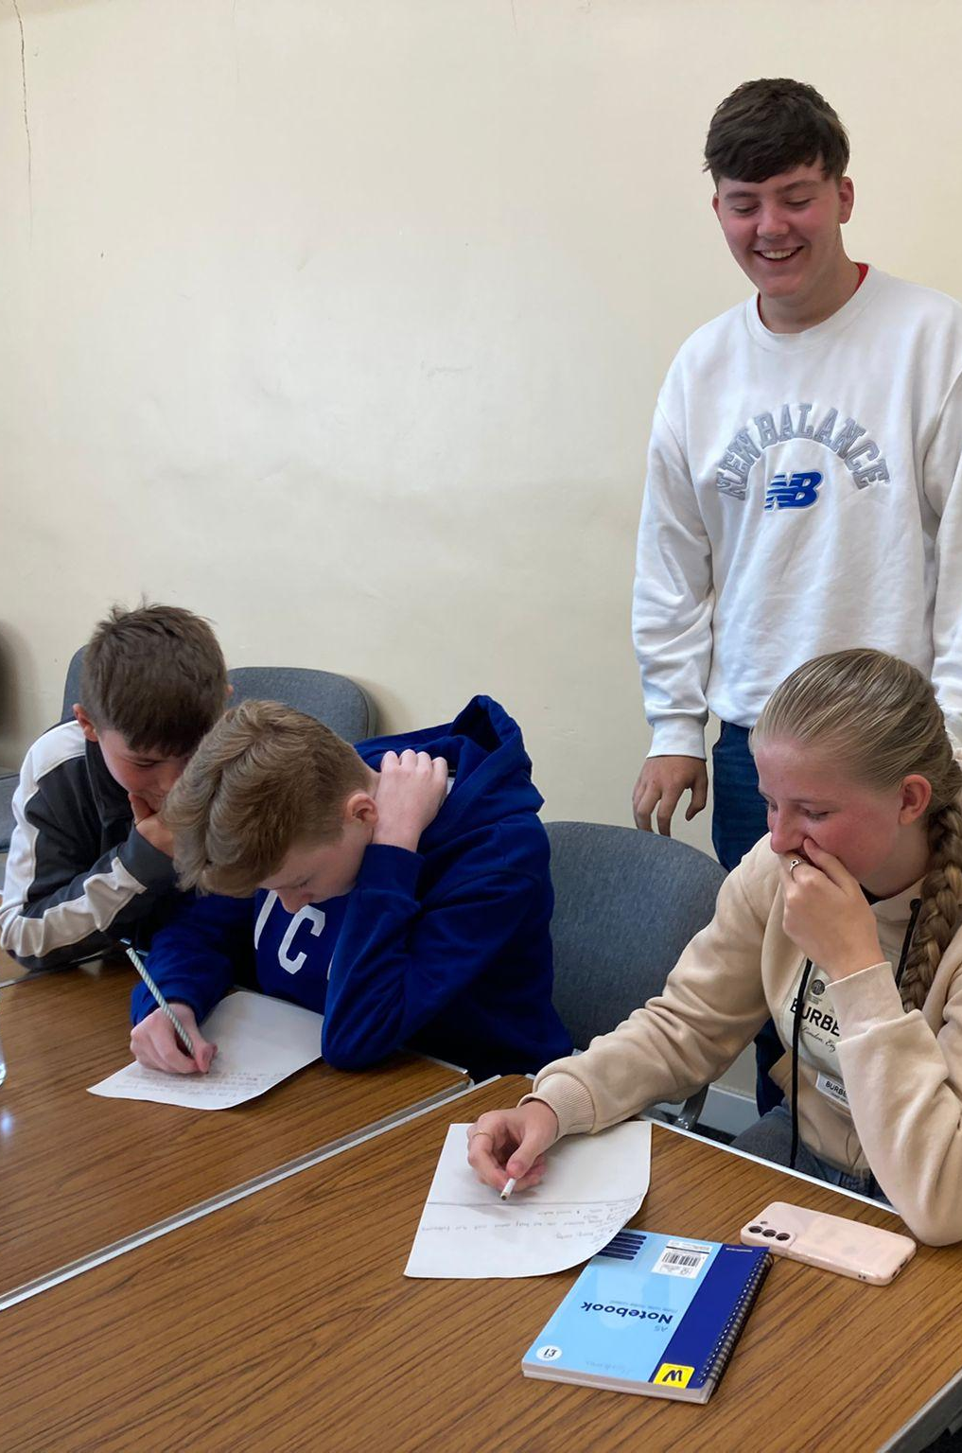
Agreed Outcome 2: Increased knowledge and participation for up to 20 [per year] young Gypsy/Travellers who are shifting or living roadside in North-East Scotland and the Scottish Highlands regarding their rights [particularly, but not exclusively, education and participation rights] as individuals and as a community. Increased engagement by young Gypsy/Travellers in the UNCRC Reporting Process and other advocacy opportunities.
8 young people have now learned about their rights through a workshop with Eilidh.
This has been a continuing process, with no major barriers when delivering these workshops beyond those noted last year, namely that the variety of ages of the young people requires Eilidh to modify the material to keep them engaged at an appropriate learning level. This continues to be particularly true of those under 13, which means Eilidh takes extra time with this age group to help bring them up to speed.
Creating e-books in Deekin: an Article 12 Education Project

Slide 24
Agreed Outcome 3: Increased knowledge and sharing of successes and lessons learned from developing a scalable model of supporting young people whose families are roadside.
After attending Moving for Change’s network event in York, Eilidh and Article 12 in Scotland’s National Co-coordinator Leslie Drury consulted with Consulting Made Easy CIC.
Eilidh continues to liaise with local partners to increase positive support of families living roadside. This includes local council workers—such as housing department, site managers, and public health workers– as well as the NHS and the Highland Council Gypsy/Traveller Improving Lives Delivery Group.
She is now being included in all Moray Council email chains - a big win - and is undertaking one-to-one meetings with partners in the Delivery Group, particularly with contacts in education, and trying to get a bigger picture through SEEMiS (the Education Management Information System in Scotland) regarding Gypsy and Traveller children who are or aren’t attending school.

Slide 25

England
York Travellers’ Trust: Local Action Plan
In the absence of a local plan for Gypsies and Travellers in York, funding from MfC enabled York Travellers Trust to hire the services of Marc Willers, KC to represent YTT’s arguments with York City Council (and counter those of the council’s own KC) with a view to ensuring the organisation had a voice within local planning discussion.

Slide 26
While the council was firmly entrenched in its position, a KC’s presence enabled YTT to be involved in those discussions, which - allied to YTT’s work with national government consultations - extended out that negotiation until such a time as York’s local policy contradicted the new national policy.
As a result, there is now a call out for new sites, where previously the only option had been the unsuitable Oswaldwicke site, and the council has to have a masterplan for these sites (for lighting, access and safety issues to be addressed). It has also set aside £5 million for site provision.
For someone planning a similar project, YTT advises against having high expectations of the power of a KC. Whilst legal representation may get you a foot in the chamber door, it doesn’t guarantee you will be heard.
However, the whole process has been a dramatic learning curve for YTT. To be part of that planning consultation process has given them the ammunition not just to change the policies but also to understand the process itself. It is an ammunition that hopefully can be shared with other small, grass-roots organisations.

Slide 27
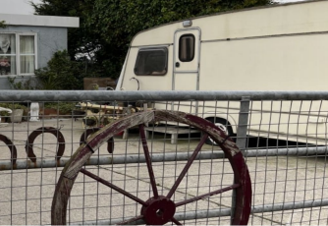
Wales
Gypsies and Travellers Wales: Rover Way
The year has seen change around the Rover Way project from both within and without. In October 2024, Emma Garnett succeeded Jay Harley in heading up the delivery of the project. We would like to take this opportunity to thank Jay for all their incredible work.
2024-25 began with Gypsies and Travellers Wales (GTW) resuming its monthly on-site residents’ meetings as well as attending the reformed Senedd Cross-Party group for Gypsies and Travellers.
As part of its mission to keep residents informed, GTW kept them up to date about the consultations on the proposed Local Development Plan for Cardiff (which may involve the temporary relocation of Rover Way), and made sure their feedback was heard as part of the consultation process.

Slide 28
Along with the publication of an Anti-Racist Action Plan, the year in policy saw GTW’s Director Louisa Devonish give evidence to the Local Government and Housing Committee in October on unmet housing needs of GRT.
With part-funding from MfC, GTW has employed a full-time Policy, Comms and Engagement Officer to undertake engagement work with the community and respond to policy documents. Meanwhile the GTW advice line service has opened up for users across Wales.
As part of that broadening of its activities, GTW engaged with consultations on child poverty, transit sites (with FFT), a Cardiff Council transit study consultation, policing, service regarding Violence Against Women and Girls as well as series of educational and health initiatives.
The issue of Rover Way remains in a state of flux, with the current proposal being to move the residents of the current site (some 30 plots) to the other side of the road while developing Rover Way itself over the course of ten years and returning them to an improved site of some 80 plots – the largest in Wales. The practical implications of that plan (who it will serve and whether it will be fully built or begun and then extended as needed) have yet to be decided but GTW remains at the heart of the consultation, working to ensure that the voices of the community are heard and acted upon.

Slide 29

Northern Ireland
Armagh Roma and Traveller Support [ARTS]: After Schools Clubs
Continuing the momentum created last year, MfC have now funded a further 12 tablets - making 15 in total - for ARTS’ after-school clubs, plus access to the Click2Learn scheme, which follows the individual progress of each of the children accessing the club. This has allowed for greater fluidity in the use of educational technology and permitted ARTS to take their after-school programme into the local schools of Armagh themselves.
Ages range from 4 to 17, with some disadvantaged by learning difficulties and others confronting severe language barriers, particularly with reading and writing, the children can also face difficulties from a system that is underequipped to deal with their lack of initial educational development. The flexibility that MfC’s funding has permitted ARTS in pursuing its educational mission has also allowed the organisation to confront some of these systematic barriers.

Slide 30
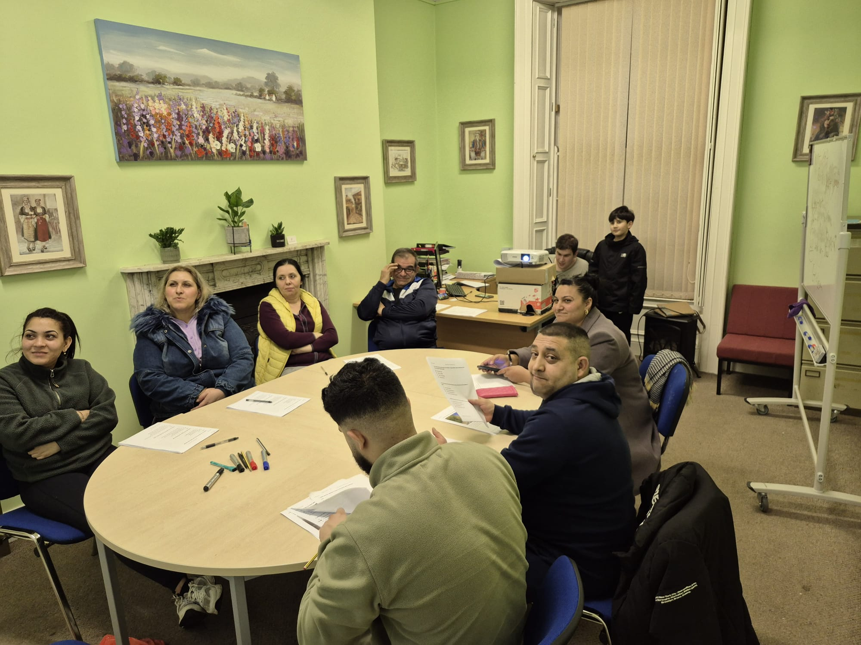
S’s Story
S is in her fourth year of secondary school. A Roma girl, she is now at the age where she should be choosing subjects for GCSEs, but is still being taught in the “newcomers class” has yet to receive an SEN assessment despite clear retention issues and being grade pointed at 75, where a minimum attainment level would be 120.
ARTS’ presence at the school in question highlighted S’ issues and led to the organisation lobbying on S’ behalf for her to receive an SEN assessment, albeit externally from the school.
S is currently receiving one-to-one extra education through ARTS’ after school sessions and is making progress, while ARTS is endeavouring to have her accepted by another school in the region better equipped to address her individual needs for the next academic year..
The story of S is not a unique one, but without the involvement of the ARTS after school initiative, and the funding from MfC for its equipment, it would have resulted in her being failed by an educational system often ill-equipped to cope with the needs of Gypsy, Roma and Traveller children.

Slide 31
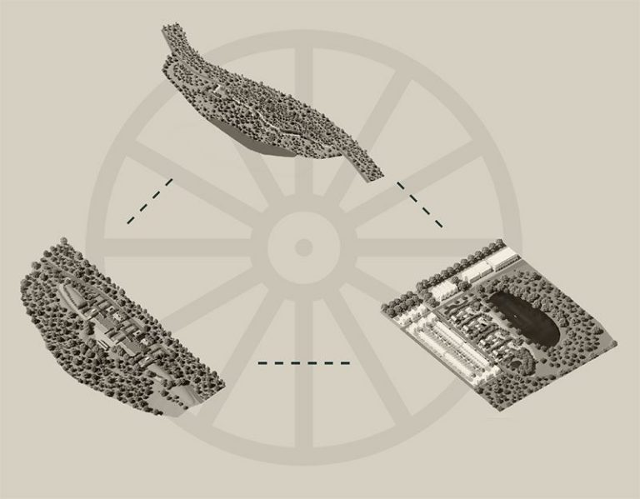
Spotlight On National Projects
The Modern Nomad
Unveiled in 2023 at the MfC Network gathering in London, The Modern Nomad began as a bold Cluster Group initiative to reimagine the future of accommodation for Gypsy and Traveller communities across the U.K. From the start, the project had a clear mission: to ensure that future planning policy and accommodation provision is not only functional, but also culturally appropriate and inclusive for the Gypsy and Traveller communities.
This has culminated in a powerful “Vision Guide” — a set of ideas, insights and illustrative guidelines that have been driven by community participation - now available on the MfC website. This guide is more than just a report; it’s a roadmap for change.

Slide 32
At the heart of the project is Irish Traveller architect Darren Ward, who led the research and interpretation of a nationwide Community Survey. The process included three phases: an initial online survey, a lively in-person workshop at the MfC Network Away Day in York (May 2024), and a refined follow-up survey based on earlier feedback. In total, a sample group of 50 + community voices helped shape the project.
What emerged is a striking collection of future visions — from reimagined bridleway living and flexible communal spaces to nature-connected plot designs that respect both traditional family structurest and future proofing such as sustainability.
Now that the Vision Guide is live and open for community feedback via email or WhatsApp, the next step is ambitious: bringing policymakers, planners, architects, environmentalists, local authorities and decision makers to the table. The goal? To turn vision into action — and to spark real, lasting change for Gypsy and Traveller communities across the UK that not only addresses basic needs but helps the community thrive.

Slide 33
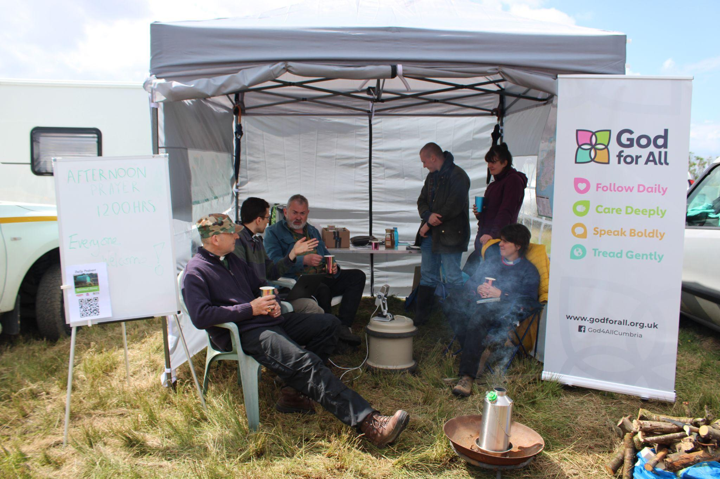
Gypsy Roma and Traveller Friendly Churches (aka Churches Network: Sanctuary Stopping [CNSS])
Its second full year of activity has seen enormous strides being taken by the Gypsy Roma Traveller Friendly Churches (GRTFC) project.
One indication of the project’s progress was the appointment of its two patrons: Stephen Cottrell, Archbishop of York, and Paul McAleenan, Auxiliary Bishop for the Roman Catholic Diocese of Westminster.
Other highlights include participation in the 4th annual Roma Networks Conference in Albania, two significant webinars – on Gypsy, Roma and Traveller accommodation, and Health and Wellbeing, a presence at Appleby Horse Fair, involvement with the United Beyond Borders missionary conference, and engagement with the youth workers of the Differences Team at Lambeth Palace.
Picture © Anna Young

Slide 34
The project has also been involved with Gypsy, Roma and Traveller issues outside of its ecclesiastical remit, promoting the activities of a wealth of Moving For Change partner activities and adding its weight – through the signatures of Reverends Nicky Chater and Jonathan Herbert to an open letter responding to the actions of Greater Manchester Police towards young Gypsies and Travellers in November.
In many ways, GRTFC has sought to reduce misunderstanding and mistrust on both sides of the church-communities divide, calling for contributions from members of the communities to a survey of their experiences with the church while also staging a series of performances across the country of the educational play Crystal’s Vardo, in association with the Church of England’s Racial Justice Unit.
GRTFC can also be seen as part of an ongoing trend among the churches to address issues of racism, with the appointments of the first two Church of England Lead Bishops for Racial Justice as well as that of the Racial Justice Education Adviser in York. How far this impetus will carry GRTFC is anybody’s guess but – with a conference at Salisbury Cathedral due to take place in July 2025 - the outlook is extremely good.

Slide 35
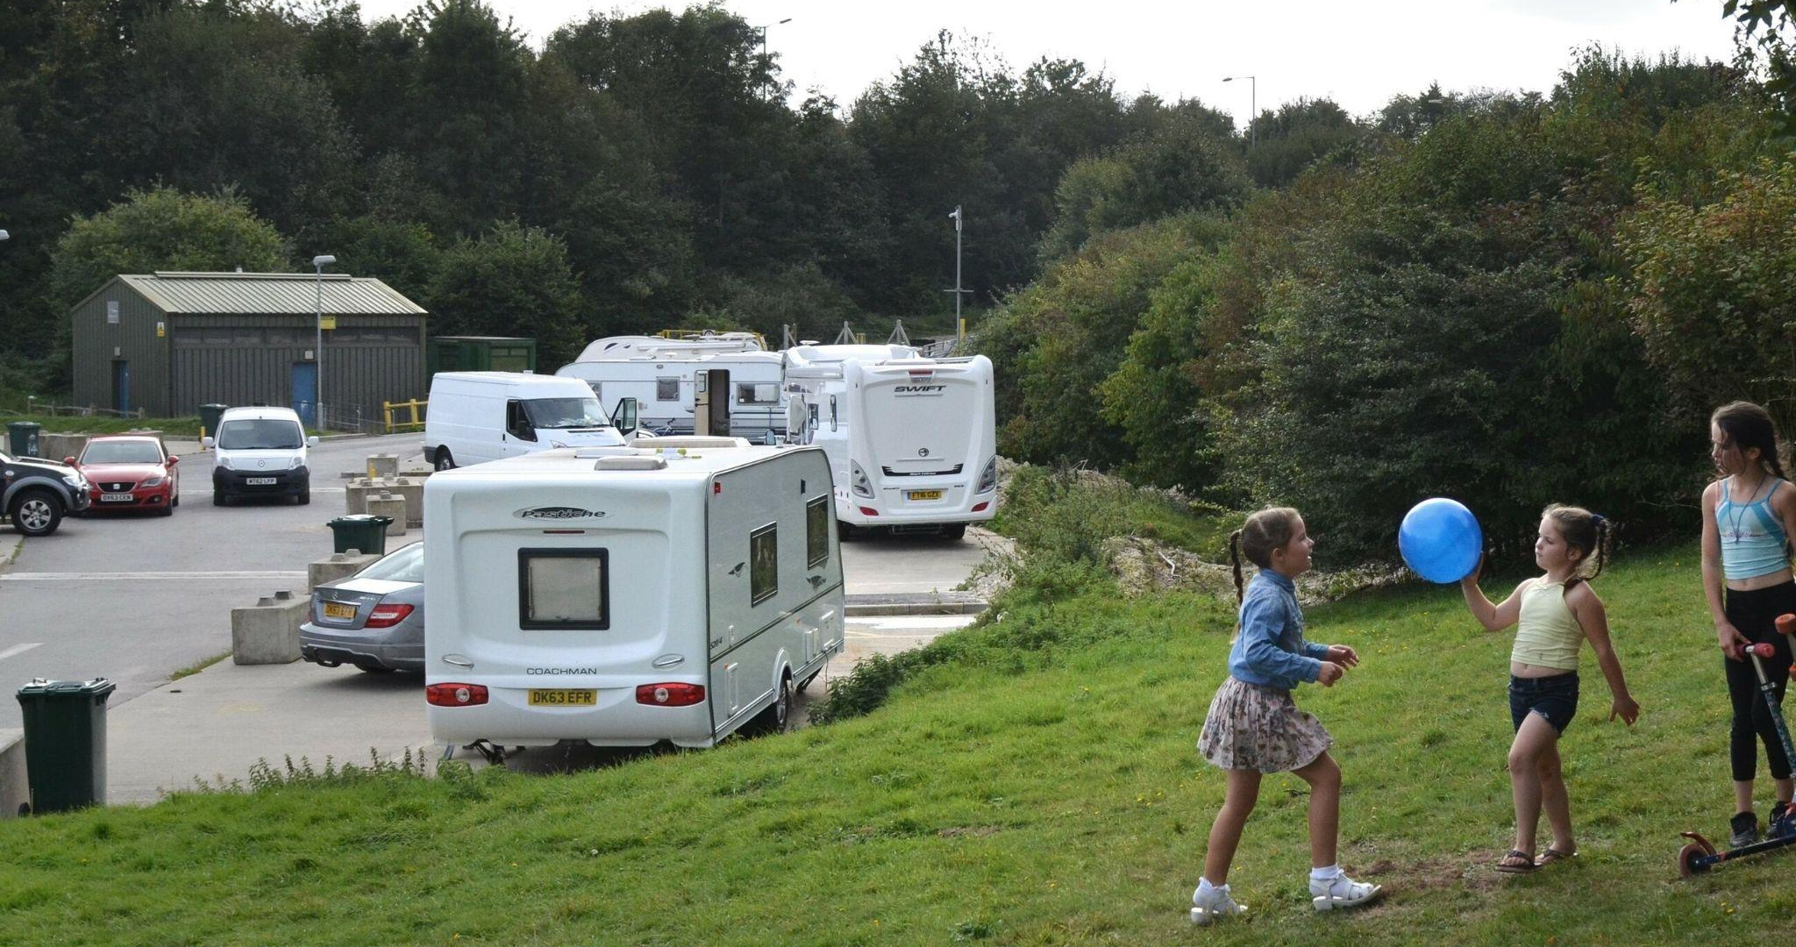
Transit Site Project
Initially set up to engage the community about their experiences of stopping places, this project developed into an overview of all kinds of stopping place. .An initial series of FoI requests, undertaken by Friends, Families and Travcellers, revealed that:
92% of authorities had no transit sites or pitches
Only 9% of local authorities reported having transit site provision.
39% of authorities with transit sites indicated that the police had used legal powers to direct Gypsies and Travellers to these sites.
74% of authorities with transit sites imposed a maximum stay between 14 and 180 days
58% of authorities enforced a minimum 'no return' period, ranging from 28 days to 365 days.
50% of authorities with transit sites charged extra fees for utilities, leading to greater financial burdens.
Picture © Mary Turner

Slide 36
Nineteen partners from across the UK were provided with interview questions, participant vouchers and consent forms. Interviews took place with 93 members of Gypsy and Traveller communities. Romany Gypsies and Irish Travellers accounted for almost two-thirds (64%), New Travellers were well represented (19%). We also heard from Welsh Gypsies, Scottish Travellers/Gypsies and two Showmen.
Some basic patterns have already become apparent:
People’s ‘ideal’ transit provision is fairly basic – clean, safe, with water, and toilet facilities.
Only 19 people we spoke to had used transit provision in the last 12 months.
48 people said there was no site provided in the area they travelled/wanted to travel.
10 people told us the costs were too high.
8 people said there was no space on the site they wanted to use.
The majority of people (82) said the local authority were NOT meeting the needs of Gypsy and Traveller communities.
As next year progresses, we expect to have a clearer view of the data we have received, but already it is becoming clear that this will be a major contributor to the future of Transit Sites across the country in years to come.

Slide 37
Spotlight On Mentorships
GATE Herts
Star Smith joined the mentee programme in February 2024 at the age of 17. Her family were already using GATEHerts’ various services, which made her aware of the possibility of mentorship.
Over the course of this year, Star has been trained in Community Development, Safeguarding and Health and Safety at Work. Although she already had some computer experience, the mentorship developed her skills in Word and Excel, the latter particularly through shadowing GATEHerts’ Finance Officer.
Star’s mentorship has also included data analysis regarding hate crime incidents, filling out progress reports, giving guidance on documents such as passport and driving licenses, and outreach with GATEHerts’ Community Advocate, to the point where a lot of young people ask for her now when they come in.
Along with the growth in her confidence, Star’s mentorship has resulted in her decision to specialise in community advocacy among Gypsies and Travellers.

Slide 38

York Travellers’ Trust
An English Traveller in her 30s, Eleanor Tunney joined the York Travellers Trust (YTT) Mentorship scheme three years ago.
Alongside community outreach and event organisation, Eleanor engaged in interviews, education research and Covid research with the University of York. With her period as a mentee finished, Eleanor has remained with YTT and is currently employed as a mental health community outreach worker.
The ripple effect of Eleanor’s progress and success has resulted in other members of the communities in York to ask if there are further opportunities for them. ,
This in itself has had a knock-on effect. The current campaign for a private site – one of the first in York – is a direct consequence of this strata of Gypsy and Traveller becoming engaged , having come to YTT because of Eleanor and the support they’ve received as a result.
Picture © YTT

Slide 39
Friends, Families and Travellers
As a mature mentee, Chris McDonagh’s relationship with Friends, Families and Travellers (FFT) was a combination of discovering new skills and developing already existing abilities. Chris’ own background of advocacy with Travellers Against Racism made him an obvious fit with FFT’s Comms and Campaigns Team.
Chris’ contributions to campaigns such as the weather survival infographics (for both hot and cold seasons) and FFT’s Anti-Racism Strategy group brought an experienced perspective from within the communities to the organisation’s engagements and reflections. Equally, his experience of health issued within – in particular – informed his personal project “Better In The Morning.”
As well as being a much-needed look at the personal and cultural reasons for not engaging with the NHS, the project also allowed Chris to develop his skills in interview technique, videography and editing methodology – increasingly vital skills as social media platforms turn more to visual than written material.
Chris is also a skilled gardener and has taken full advantage of the opportunities available through his menteeship to undertake further courses in horticulture. Chris’ time with FFT as a mentee has come to an end, but not his relationship with both them and MfC. We wish him every success in his future endeavours.

Slide 40
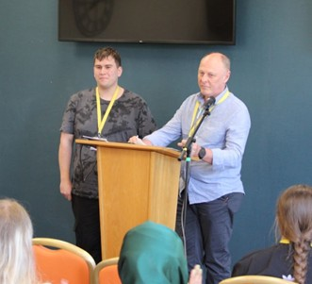
Armagh Roma and Traveller Support (ARTS)
ARTS has an individual approach to the mentor scheme, with the year seeing the organisation take on four mentees.
Chair Peter Wilkinson believes that the scheme in his region is best employed by trying to give as many individuals as possible the opportunity to develop in the time that they need, then get on with their lives rather than having them commit to a lengthy two-year programme.
While Mary Patricia’s engagement only lasted six months, it resulted in the offer of a place at Southern Regional Campus. Meanwhile, elsewhere in the education system, Svetla’s menteeship has allowed her to boost her English and Maths for GCSE, while at the same time helping out with ARTS’ own after-schools clubs, in particular their English class, as well as a Women’s Group, where she gets to translate for some of the women attending.
Also attending school. Chrissy’s mentorship is allowing her to take the exams she will need to decide what course she wants to follow in life.
Peter and Stoyan address the MfC Network

Slide 41
Between school and university, still deciding on what – if any - university course to take, Stoyan is the only boy being mentored by ARTS this year and has been specialising in gaming and IT. His menteeship has involved looking after ARTS’ website and social media platforms as well as leading the Driving Theory course offered by the organisation.
Regardless of academic achievement, Peter echoes other mentorship providers by emphasising that the confidence gained by mentees and the realisation that they have options they can choose to either follow or leave to one side is the main benefit of the programme, along with the fact that these mentees’ experiences have a ripple effect throughout their communities. In Peter’s words:
“It's like a network for them, too, and then for us, because then they tell other people about what we do. Kind of about different opportunities and things that you're given. They'll say, “Go in there and see what they can do for you.” And then they come in to make that wee change and that step up. And by helping one or two, it spreads the word. Without knowing, you probably have 10 or 11. It broadens right into one big family tree.”

Slide 42
Concluding Observations
Despite the changes of the year in terms of national government and internal organisation, and having faced challenges from both online critics and the negative treatment of members of our communities across the country, MfC continues to be proud of its achievements and resilience.
We have continued to be in a position to provide respite and peace of mind, this year to 130 individuals and families through our crisis grants. We have sustained the funding of initiatives both large and small. Meanwhile, our regional and national projects have enabled us to further enhance our position as an entity that not only seeks to bring real and sustainable change for Gypsy, Roma and Travellers across the UK but also responds to immediate need.
As with previous years, we are proud of the way we have developed over this reporting period and move into our final lottery-funded year of 2025 with pride and hope.

