Slide 1


IN SCOTLAND

Slide 2
Education Matters
Exploring Barriers and Solutions

Slide 3
Activities:
Groups will rotate between each of the activity stations.
🧤Gloves & Sweeties🍬
🪞Mirror & Star✨
🙈Blindfold & Chair🪑

Slide 4
How did it feel to do a simple task with gloves on?
What barriers do GRT’s face in accessing education?
What made the star task harder?
How might GRT students feel in a system that’s unfamiliar to them?
How did it feel to rely on someone for guidance?
How can we better support GRT students as they navigate education?
What did these activities teach us about the challenges?
How do these activities connect to real-life barriers in education?

Slide 5
Barriers on the Wall
  Identifying and exploring systemic and cultural barriers GRT students face in education.
  Identify a barrier (transport issues, rigid policies) and write it on a sticky note.
  Map the impact of the barrier (school disengagement) and place it near the relevant barrier.
  Add solutions (flexible appointments, relationship-based communication) next to the barriers.

Slide 6

Transition Challenges
Frequent shifting:
Changing schools, disrupted learning, adapting to new systems, environments, and peer groups.
Cultural Disconnect:
Feelings of isolation, disconnected from peers, lack of awareness of their cultures in the curriculum or school.
Stereotyping and Discrimination:
Bullying, negative experiences affecting confidence and willingness to engage with school.
Family Expectations:
Family may not prioritise education over traditional roles or shifting.

Slide 7
Supporting Transitions
  How do we ensure a smooth transition from primary to secondary school or college?
  Mentorship Systems (Peer or community-based)
  Personalised Plans (Recognising cultural factors)
  Cultural Awareness Training (For staff)
  Early Family Engagement (In the transition process)

Slide 8
Alternative Curriculum
  Exploring strategies for flexible and inclusive education:
  Blended Learning (Mixing in-person and online)
  Flexible Timetables (To accommodate family or travel needs)
  Culturally Relevant Content (Incorporating GRT culture into the curriculum)
  Practical, Vocational Learning (Real-world practical learning)

Slide 9
  Key Takeaways:
    Understanding barriers GRT learners face
    The need for flexible learning models
    Supporting smooth transitions

Slide 10

Understanding culture and challenges

Slide 11
in Scotland
Contact us:
www.article12.org
admin@article12.org
Or find us on Facebook and Bluesky

Slide 12

UNCRC Article 12
Every child has the right to express their views, feelings and wishes in all matters affecting them, and to have their views considered and taken seriously.

Slide 13
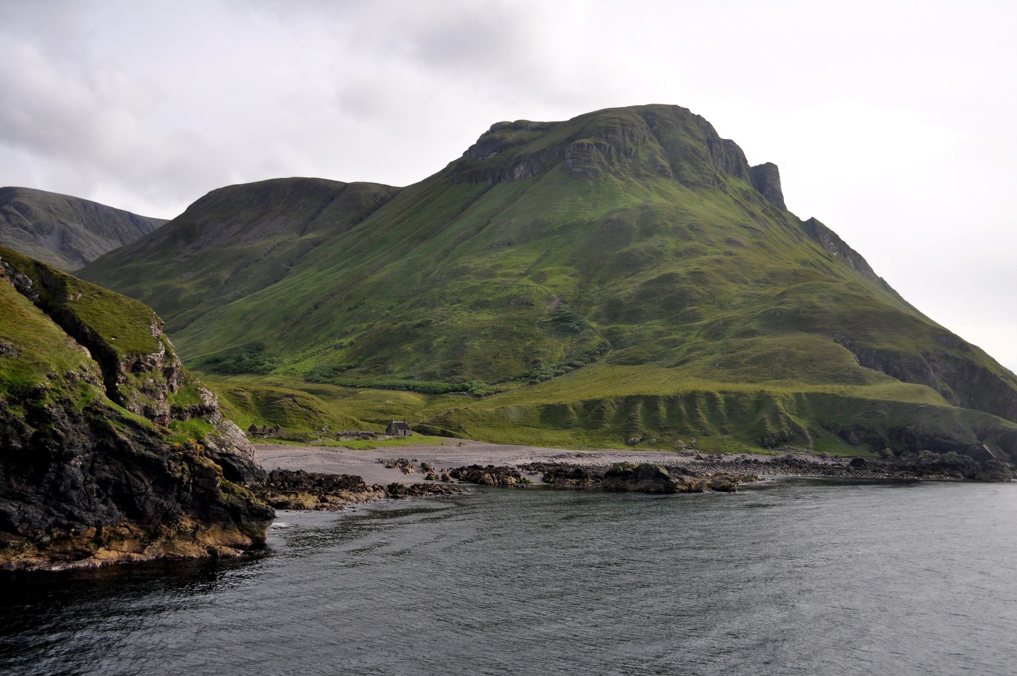
Activity: Rights Village
Notes:
Breakout ACTIVTY: Island Village (one of many activities to learn more, basic understanding of the UNCRC and likely a wants/needs warmup)
A small, new village has been built on a remote Scottish Island, no-one has ever lived there and so far, only houses have been built. There are no laws, no rules and no history. You will all be settlers here and in preparation, your group has been given the responsibility of deciding which 10 institutions or recreational facilities should be in your village.
Split into pairs or groups [this could also be done individually]. Participants have to choose the name for the village. The young people then decide what is to be in their village.
Depending on time, participants can draw the village or simply list what they want there. They must be specific, for example, they can’t just say shops: it would have to be a supermarket or a chemist.
Hand out the Articles of the Convention. The young people look at what is in their village and write the Article or right it covers - for example, if they have a hospital, they would write beside it Article 6, Article 23.

Slide 14
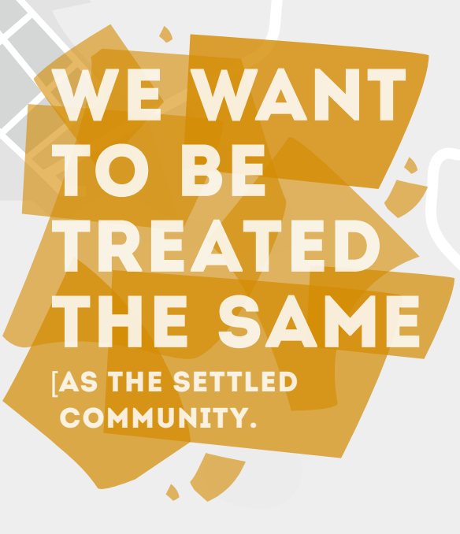
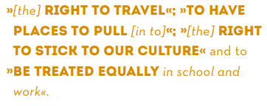
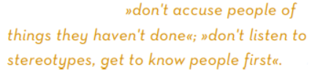

Slide 15

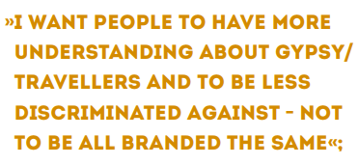
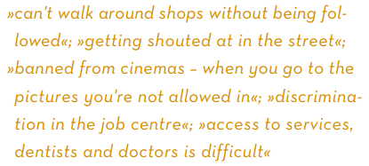



Slide 16
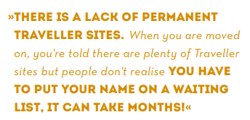

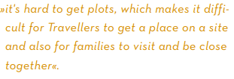
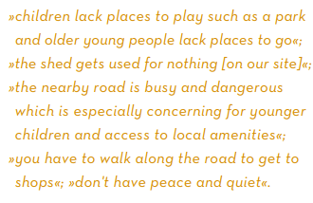


Slide 17




