Slide 1
Friends, Families and Travellers (FFT)
Physical health and wellbeing

Slide 2
What is health & wellbeing
Health is a state of complete physical, mental and social well-being and not merely the absence of disease or infirmity.“ (World Health Organisation)
For us it is important to highlight to be healthy you need good physical and mental health.

Slide 3
What does data suggest with health & wellbeing in GRT communities?
Romany and Traveller people face life expectancies between ten and 25 years shorter than the general population (Human rights commission)
The health of a Romany or Traveller person in their 60s is comparable to an average White British person in their 80s (University of Manchester)
An All Ireland study found that suicide prevalence is six times higher for Irish Traveller women than women in the general population, and seven times higher for Traveller men (University College Dublin)

Slide 4
Why is this the case?
Lack of site provision
Wrongful registration refusal in primary care
Digital exclusion and lack of accessible information
Inequalities in mental health and access to mental healthcare
Feeling of isolation/loneliness caused by discrimination significantly impacting mental heath
Services not considering the communities who we support and services not being accessible inclusive for our communities

Slide 5
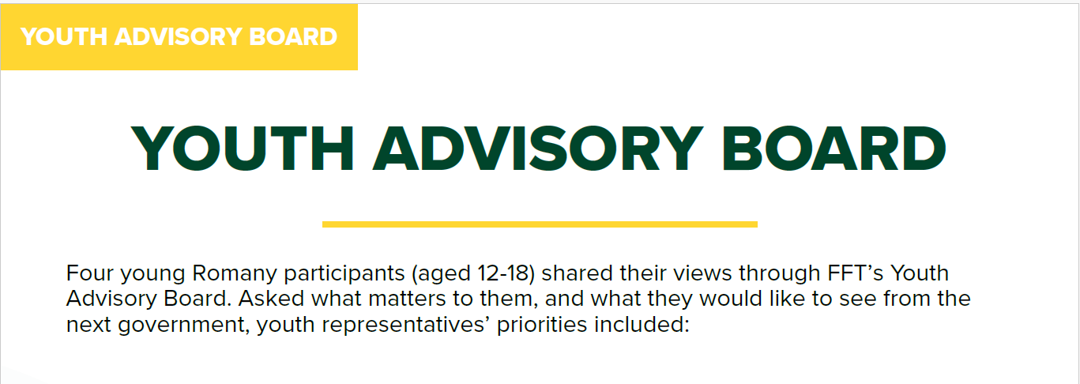

Slide 6
What is important to our young people
We have developed a youth manifesto with our youth advisory from what they wanted from the next government some points are below:
Focus on cost of living and decreasing cost of food.
More funding for mental health services.
More funding for drug support services.
Stop the closure of swimming pools and open more.

Slide 7
Young health champion model
Qualification was co-produced with young people.
Qualification is delivered across two full days.
Once the young people complete the qualification and if they pass, they secure a level 2 qualification and have the information to be a health champion in their community.
We support the young people develop their skills/knowledge including making young people aware of their local services.
Group have to create a health message some examples include giving up smoking and reducing consumption of alcohol.

Slide 8
What are the aims/objectives of the qualification?
Increasing awareness of healthy lifestyles and encouraging involvement in activities to promote good health.
Providing peer support through an understanding of the individual and social drivers of healthy and unhealthy behaviours.
Delivering positive health messages to peers and wider communities.
Signposting local health services to support health improvement.
Developing skills for the workplace and personal development to add to their CV.
This qualification is valuable for young people interested in health improvement, future employment in health and social care, and those looking to support their peers in relation to health and wellbeing.

Slide 9


Slide 10
How we have delivered our health champion model
Worked closely with University of Sussex widening participation team to get access to schools
Worked with other organisations including London Gypsy and Travellers.
Worked with schools across Sussex to deliver it to GRT young people.
Delivered the qualification in community settings across Sussex such as sites the young people live on.

Slide 11
Lessons learnt/challenges with RSPH
Some Challenges experienced:
Losing key contact points at schools for example key members of staff at schools going on maternity leave.
Students wanting to take the qualification however data monitoring at the school might not have them down as GRT.
Finding suitable locations to hold RSPH on sites most sites around Sussex are old and do not have community rooms on them and are in rural locations.

Slide 12
Lessons learnt/challenges with RSPH
Some lessons learnt:
We always try to maximise our relationship with schools and work with them to build an inclusive environment for GRT young people such as supporting them to recognise GRT history month.
Working with London Gypsy and Travellers has been a fantastic connecting in growing this area of work.
Ensure we always collect young peoples feedback to improve the qualification to ensure engagement is good for example we now include a vaccine game.

Slide 13
The impact of the qualification and feedback
Since the start of this programme 73 young people have engaged in the qualification.
92% of young people who have taken the qualification now feel more confident sharing health information and signposting friends/family onto health services.
100% of young people who have taken the qualification confirmed they have increased understanding of health services.
93% of young people gave positive feedback for the qualification.
Delivered qualification across 6 schools and we are a key contact point for them and helping them build an inclusive environment and developing their practice working GRT communities.

Slide 14
Youth work expanded on
Youth clubs across Sussex
Education drop-in sessions
Family and youth work focused casework
Youth advisory board
Supporting young people into work experience

Slide 16
What do you feel are the main health issues impacting young GRT people?

Slide 17
How can young people create change within health systems so they are more accessible for GRT communities?

Slide 18
Do you think the progress of technology such as NHS services going online will help improve access to services in the next 10-20 years?

Slide 19
Do you have any suggestions on how we could grow our young health champion model?

